Slide 1



Lifetime analysis for everyone
Matthias Gehre
Gábor Horváth
Notes:
I have a poster (SLX FPGA)

Slide 2
Lifetime?
Notes:
So let’s talk about lifetime
It’s important because crashes and data corruption, possibly silent data corruption, are what we suffer when we don’t manage our object lifetimes correctly.
This is one of the most common ways to shoot yourself in the foot
We will first look at object lifetimes in C++,
the rules we need to learn
and how tools can help us.
Especially the dreaded dangling pointers

Slide 3
Lifetime?
😃 works
int main() {
auto Name = input();
cout << “Hello “ << Name << ‘\n’;
return 0;
}
😞 doesn’t
const char* input() {
string Line;
getline(cin, Line);
return Line.c_str(); // Oops
}
💥 garbage
Notes:
It’s a rainy day outside, you look at this code.
On CentOS 7, seems to work fine
On Ubuntu 18.04, either prints garbage (when input is small) or empty name when input is larger
On MSVC it occasionally prints garbage, occasionally prints the right thing, not deterministic
-> work on my machine (but not at customer)
Looking at input(), we find the problem:
Returns a pointer into the local string Line, which goes out of scope
Accessing that pointer in main() is undefined behavior -> anything can happen
Who thinks this bug is easy to spot here?
The compiler will not warn!
Because the compiler does not diagnose this, it takes a part of my brain capacity
just to search for those kind of issues in code.
btw, If you want to know why those behave in those ways, talk to me after the talk.

Slide 4

Don’t mess with the dead
70% of security patches by Microsoft fix memory errors
https://youtu.be/PjbGojjnBZQ

Slide 5
Object Lifetime - Temporaries
string getString();
void f() {
cout << “Hello “ << getString() << ‘\n’;
}
😃
temporary destroyed at end of full-expression
void g() {
string_view Name = getString();
cout << “Hello “ << Name << ‘\n’;
}
💥
temporary destroyed at end of full-expression
void h() {
const string& Name = getString();
cout << “Hello “ << Name << ‘\n’;
}
😃
temporary is lifetime-extended by const&
Notes:
the temporary will last until the end of the full expression, i.e. until after cout has printed to the screen and returned
string_view will point to a temporary string -> the compiler will not warn!
const string& will point to a temporary string -> but it causes lifetime extension
using a non-const lvalue reference would be a compile-time error; (non-const) rvalue-references also cause lifetime extension
lifetime-extension does not work when (non-polymorphic) type conversion at play
See also https://abseil.io/tips/107

Slide 6
Object Lifetime - Subobjects
struct FullName {
string First;
string Last;
};
FullName readFullName();
const string& getFirst() { return First; }
void f() {
const string& Name =
readFullName().First;
cout << “Hello “ << Name << ‘\n’;
}
void g() {
const char* Name =
readFullName().First.c_str();
cout << “Hello “ << Name << ‘\n’;
}
😃
temporary FullName is lifetime-extended
💥
c_str() returns no temporary string
Notes:
On left side, temporary FullName is lifetime extended by Name const&
On right side, Name is dangling. There is no lifetime extension because c_str() does not return a temporary. It returns a const char*.
The compiler will not warn!
Question to the audience: what would happen if we replace First with getFirst()?

Slide 7
Object Lifetime - Range-based for
string readInput();
for(char C: readInput()) {
if (C != ‘ ‘)
cout << C;
}
optional<string> mayReadInput();
for(char C: mayReadInput().value()) {
if (C != ‘ ‘)
cout << C;
}
auto&& __range = readInput();
auto __begin = __range.begin();
auto __end = __range.end();
for(; __begin != __end; __begin++) {
char C = *__begin;
[...]
}
string& optional<string>::value();
auto&& __range = mayReadInput().value();
[...]
😃
💥
Notes:
call to readInput() will create a temporary. How long will it stay alive?
range-based for loop is sugar for the following code. The range itself is bound to a rvalue reference, which causes lifetime-extension.
std::optional::value() returns a reference thing inside the optional (here: vector<string>).
So auto&& does not cause lifetime extension (it sees no temporary object)
Then the temporary optional is destroyed at end of full-expression before the loop body.

Slide 8
Object Lifetime - Ternary
void prettyPrint(const string& Thing) {
string_view Pretty = Thing.empty() ? “<empty>” : Thing;
cout << Pretty << ‘\n’;
}
string_view Pretty = Thing.empty() ? “<empty>” : Thing;
const char[6]
string
if (Thing.empty())
Pretty = string_view(string(“<empty>”));
else
Pretty = string_view(string(Thing));
💥
Notes:
Ask who thinks there is a bug if thing is empty? Who thinks there is a bug if thing is not empty?
Types of “<none>” and thing don’t match – value category also does not match
Both (!) need to be converted to match so both get a temporary
On clang trunk -O2, both cases produce garbled output
On gcc trunk -O2, only the thing case (!) produces garbled output
Compiler produces no warnings!
https://godbolt.org/z/6bOFAZ
Herb:
the committee wanted to yank string_view from the standard because it was so dangerous in such examples, but this analysis was instrumental in convincing them we could diagnose them and so string_view could ship

Slide 9
Lifetime ends
Local Variables: end of their scope
Temporaries: end of the full-expression, unless ...
… lifetime-extended by const& or &&: together with the reference
Type conversions introduce temporaries!
Notes:
class objects initialized by a trivial default constructor, non-class objects, arrays of those, etc.), lifetime begins when the properly-aligned storage for the object is allocated and ends when the storage is deallocated or reused by another object.
We can also summarize the lifetime extension when subobjects are involved
Herb had a funny insight that people did not want string_view to get through and the demonstration of the lifetime analysis being possible was one of the reason the finally accepted it.

Slide 10
The good news ...
All examples will be diagnosed by Clang 10
by default.
MSVC version is coming.
Notes:
SWITCH AFTER CLANG -> Gabor
Also available via clangd, clang-tidy, etc -> if you cannot update your compiler, you might still update your editor (e.g. vscode with clangd) or CI pipeline (using clang-tidy)
You can play with it on Compiler Explorers “clang (trunk)”. Should we mention JetBrains here? We can also mention that it is coming to MSVC, but we cannot say any timeline.
Also available via clangd and clang-tidy. clangd is an implementation of the language server protocol provides IDE’s with the language specific parsing,
lookup and diagnostics. PLugins for many IDEs. I use it in VS code. -> warnings directly while typing.
Mention some IDEs that support Clangd
Some IDEs/Editors with Clangd plugins:
Vim
VS Code
Atom
Emacs
Sublime
CLion
Eclipse

Slide 11
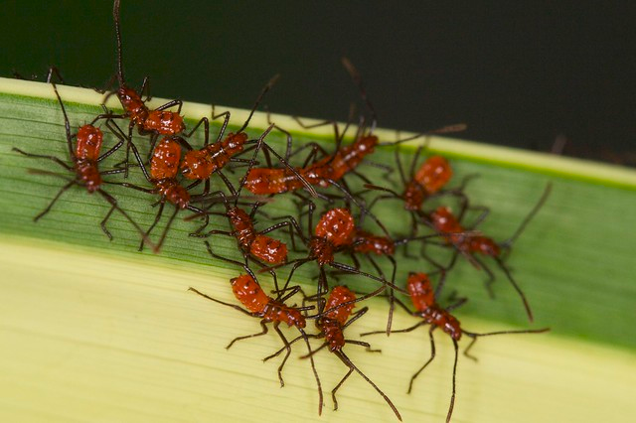
Do we actually make such mistakes?
Chromium
LLVM*
OpenSceneGraph
Cups Filters
VTK
Standard’s io2d Proposal Ref. Impl.
more…
Notes:
NO FALSE POSITIVES!
All bugs were reported, most are already fixed
in Clang half of the lifetime issues could have been prevented: we identified 22 and 11 was detected (after annotating StringRef)
These are only the errors that slipped through the review, tests, build bots, we expect to catch even more during the development inner loop

Slide 12
const string& Module::getModuleIdentifier();
template <typename Func>
auto withModuleDo(Func&& F) const
-> decltype(F(declval<const Module&>())) {
auto Lock = TSCtx.getLock();
return F(M);
}
string_view IRMaterializationUnit::getName() const {
if (TSM)
return TSM.withModuleDo(
[](const Module& M) {
return M.getModuleIdentifier();
});
return “<null module>”;
}
💥

Slide 13
const string& Module::getModuleIdentifier();
template <typename Func>
auto withModuleDo(Func&& F) const
-> decltype(F(declval<const Module&>())) {
auto Lock = TSCtx.getLock();
return F(M);
}
string_view IRMaterializationUnit::getName() const {
if (TSM)
return TSM.withModuleDo(
[](const Module& M) {
return M.getModuleIdentifier();
});
return “<null module>”;
}
💥

Slide 14
const string& Module::getModuleIdentifier();
template <typename Func>
auto withModuleDo(Func&& F) const
-> decltype(F(declval<const Module&>())) {
auto Lock = TSCtx.getLock();
return F(M);
}
string_view IRMaterializationUnit::getName() const {
if (TSM)
return TSM.withModuleDo(
[](const Module& M) {
return M.getModuleIdentifier();
});
return “<null module>”;
}
💥

Slide 15
const string& Module::getModuleIdentifier();
template <typename Func>
auto withModuleDo(Func&& F) const
-> decltype(F(declval<const Module&>())) {
auto Lock = TSCtx.getLock();
return F(M);
}
string_view IRMaterializationUnit::getName() const {
if (TSM)
return TSM.withModuleDo(
[](const Module& M) {
return M.getModuleIdentifier();
});
return “<null module>”;
}
💥

Slide 16
const string& Module::getModuleIdentifier();
template <typename Func>
auto withModuleDo(Func&& F) const
-> decltype(F(declval<const Module&>())) {
auto Lock = TSCtx.getLock();
return F(M);
}
string_view IRMaterializationUnit::getName() const {
if (TSM)
return TSM.withModuleDo(
[](const Module& M) {
return M.getModuleIdentifier();
});
return “<null module>”;
}
💥

Slide 17
const string& Module::getModuleIdentifier();
template <typename Func>
auto withModuleDo(Func&& F) const
-> decltype(F(declval<const Module&>())) {
auto Lock = TSCtx.getLock();
return F(M);
}
string_view IRMaterializationUnit::getName() const {
if (TSM)
return TSM.withModuleDo(
[](const Module& M) -> string {
return M.getModuleIdentifier();
});
return “<null module>”;
}
💥

Slide 18
const string& Module::getModuleIdentifier();
template <typename Func>
auto withModuleDo(Func&& F) const
-> decltype(F(declval<const Module&>())) {
auto Lock = TSCtx.getLock();
return F(M);
}
string_view IRMaterializationUnit::getName() const {
if (TSM)
return TSM.withModuleDo(
[](const Module& M) -> string_view {
return M.getModuleIdentifier();
});
return “<null module>”;
}

Slide 19
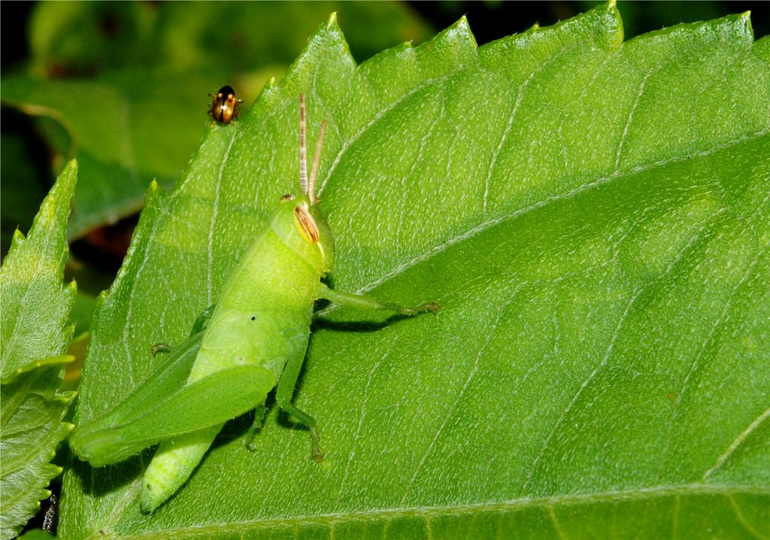
Can you spot the bug?
const char* Text =
(“Content moved to ” +
xdg_data_home + “/openspades”).c_str();
Notes:
rehearse
we need contextual information, the type of xdg_data

Slide 20
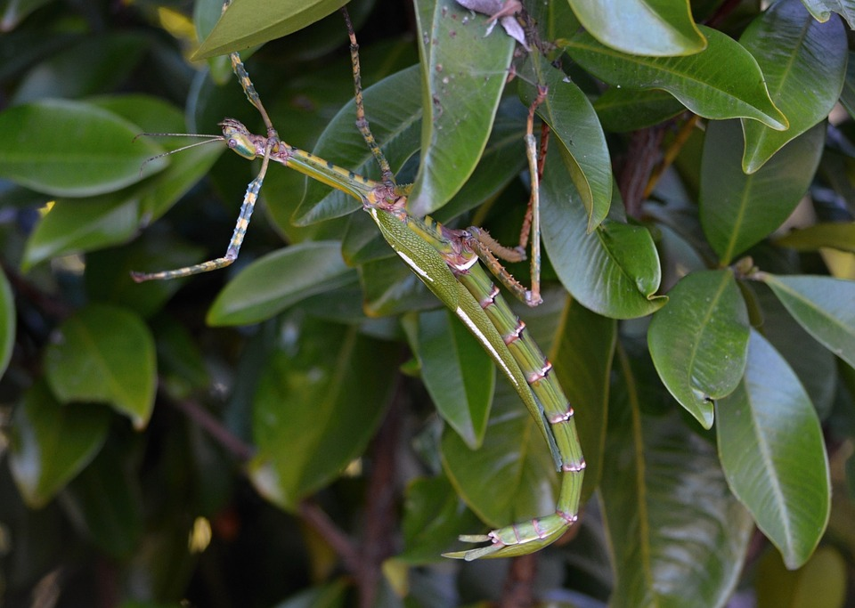
Can you spot the bug? #2
const char* f(const string Data) {
return Data.c_str();
}
Notes:
from chromium

Slide 21
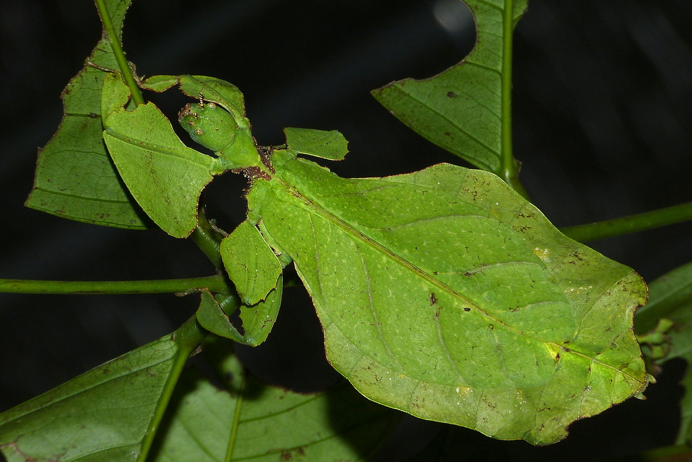
Can you spot the bug? #3
X(unique_ptr<int> Up) : IntRefField(*Up), UniquePtrField(move(Up)) {}

Slide 22
Aren’t sanitizers sufficient?
Use sanitizers if you can!
Sometimes you cannot
and they have false-negatives
False-negative:
string f() { return “CppCon”; }
void g(char*);
int main() {
string_view V = f();
char T[50];
g(T);
cout << V[40] << endl;
}
Notes:
Not every developer runs test on a sanitized build
Reduce build bot noise
Not every project has good coverage
Almost every project has uncovered parts (error paths likely to be untested)
Sanitizers do not support every architecture / memory overhead prohibitive on some embedded (gaming consoles)
Some incompatibilities with other safety measures such as _FORTIFY_SOURCE
Warnings give faster feedback
Dynamic analysis can have false negatives
Address sanitizer only checks if a memory is allocated, does not check if it belongs to the right object
Why choose? Why not both?
Projects from earlier are sanitized, fuzzed

Slide 23
How do the warnings work?
Notes:
Matthias

Slide 24
Idea
Subset of Herb Sutter’s paper ^{[1]}
Categorize classes into
[1] https://github.com/isocpp/CppCoreGuidelines/blob/master/docs/Lifetime.pdf
dies
Pointer
points at/into
Owner
Notes:
Lifetime analysis idea was first presented by Herb Sutter at CppCon 2015
together with the C++ core guidelines. In the “profiles” section of C++ core guidelines,
this is the third profile after “type safety” and “bounds safety”.
Subset = NO-false-positive subset
The detailed paper together with a first implementation (outside of main clang) was presented last year at CppCon 2018.
TODO

Slide 25
Examples
dies
Pointer
points at/into
Owner
raw pointers (int *)
references (char &)
iterators
ranges
string_view
span
[...]
can dangle
unique_ptr
vector
string
optional
variant
[...]
hands out Pointers
Notes:
For raw pointer, raw references to local variables, compilers already warn.

Slide 26
Rules
Track what a Pointer points at when
constructing from an Owner
span::span(Container&)
returning from an Owner
const char* string::c_str()
constructing from a Pointer
string_view::string_view(const char*)
Diagnose when
initializing a Pointer variable from a temporary Owner
const char* p = string(“oh”).c_str();
returning a Pointer to a local or temporary Owner
string s;
return s.c_str();
(Also on subobjects)
Notes:
returning from an Owner:
Mention std::string conversion operator to std::string_view
Rules are restricted to a single statement
-> this makes them fast and they have no false-positives (i.e. can be on by default)
-> they don't catch all lifetime issues (we will come back to that)

Slide 27
Enable the analysis for your types
Notes:
All types from the standard library are supported out-of-the-box, e.g. string, string_view, span, vector, map, etc.
We will now see how to enable it for your own types.

Slide 28
[[gsl::Pointer]]
class [[gsl::Pointer(string)]] LazyToUpper {
const string& S;
public:
LazyToUpper(const string& S) : S(S) {};
string upperCase();
};
void f() {
LazyToUpper L(“hi”);
cout << L.upperCase();
}
warning: object backing the pointer will be destroyed at the end of the full-expression [-Wdangling-gsl]
Notes:
The analysis considers all appropriate std types as Pointers.
For your custom type, use the gsl::Pointer attribute. in parentheses, it takes the type that the pointer points to.
It is optional, and will later be useful to enable function attribute inference.

Slide 29
[[gsl::Owner]]
template<typename T, unsigned N>
class [[gsl::Owner(T)]] SmallVector {
[...]
};
span<int> f() {
SmallVector<int, 4> V;
V.push_back(42);
return V;
}
warning: address of stack memory associated with local variable 'V' returned [-Wreturn-stack-address]
Notes:
SmallVector is like a vector of T. It’s optimized for the case where N or less elements are inside the vector,
in which case it does not allocate on the heap and instead keeps all elements inside (on the stack).
std::array<T, N> Small;
std::span added in C++20
Like a string_view, a non-owning. Unlike string_view, provides a mutable view to the data.
#include <string>
#include <iostream>
#include <string_view>
using namespace std;
template<typename T, unsigned N>
class [[gsl::Owner(T)]] SmallVector {
public:
T* data();
operator string_view();
};
#if 0
span<int> f() {
SmallVector<int, 4> V;
V.push_back(42);
return V;
}
#endif
string_view f() {
SmallVector<int, 4> V;
//V.push_back(42);
return V;
}

Slide 30
Upstreaming: Next steps
Notes:
Implemented but not yet ready

Slide 31
-Wsuggest-lifetime-category
For [[gsl::Owner]]:
satisfies standard Container reqs. and user-provided destructor
has unary operator* and
user-provided destructor
publicly derived from an Owner
Rules from Herb Sutter’s paper
For [[gsl::Pointer]]:
satisfies std::ranges::range concept
satisfies standard LegacyIterator reqs.
publicly derived from a Pointer
Notes:
Warning flag that will suggest to add [[gsl::Owner]] / [[gsl::Pointer]] attributes to your class
based on its interface (does not check implementation)
The rules can be found in Herb Sutter’s paper
Owner:
Standard container reqs (in standard or on cppreference) => typedefs such as value_type, members such as begin() and end(). Example: vector
Example: unique_ptr
Example: ?
Pointer:
Range => Copy constructible, copy-assignable. increment operator, deref operator, Example: string_view
Example: vector::iterator
Example: ?
Implemented in our branch but not upstreamed yet. -> will show at the end where to play with those

Slide 32
Function annotations
const char* find(const string& Haystack, const string& Needle);
void f(const string& toFind) {
const char* P = find(“Hello”, toFind);
[...]
}
Notes:
SWITCH TO GABOR
Some std functions already annotated

Slide 33
Function annotations
const char* g(const string& A, const string& B)
void f(const string& C) {
const char* P = g(string(“Hello”), C);
[...]
}
[[gsl::post(lifetime(g, {A, null}))]];
warning: object backing the pointer will be destroyed at the end of the full-expression [-Wdangling-gsl]

Slide 34
Function annotations
const char* g(const string& A, const string& B)
[[gsl::post(lifetime(g, {A, null}))]] {
[...]
return &B[1];
}

Slide 35
Function annotations
template <typename It, typename T> It find(It Begin, It End, const T& Val)
void f(const string& toFind) { [...]
auto P = find(a.begin(), b.end(), toFind);
[...]
}
[[gsl::pre(lifetime(End, {Begin}))]];

Slide 36
Limitations?
string_view f() {
string Local;
string_view V = Local;
return V;
}
Notes:
What we’ve seen so far, we call “statement local analysis”
Gabor

Slide 37
Implemented Extensions [-Wlifetime]
Flow-sensitive analysis (branches, loops, exceptions)
Nullness of Pointers
Owner invalidation
Automatic inference of function annotations
Automatic inference of [[gsl::Pointer]] / [[gsl::Owner]]
Notes:
SWITCH to MATTHIAS
Implemented in our branch but not upstreamed yet.
Not enabled by default; opt-in
Almost all of Herbs Paper
Flow-sensitive analysis (branches, exceptions)
Extend rules from one statement to the next statement (pset)
For each local variable that is a Pointer, track the set of Owners it points to/into
Diagnose when using a dangling Pointer
Nullness of Pointers
Track when Pointers are null
Warn when a null Pointer is dereferenced or when passed to a function that expects non-null
remove null from pset when explicitly checked in a if condition (or assert)
Owner invalidation
Invalidate Pointers when Owners they point into are invalidated (std::vector::push_back invalidates its iterators)
Automatic inference of function annotations
Categorized parameters into inputs & outputs
Use DerefType to see from which Input and Output Pointer can be derived from
Automatic inference of [[gsl::Pointer]] / [[gsl::Owner]]
Use the rules as discussed on the “Suggest type categories” slides
[See previous talk]

Slide 38
Flow-sensitive analysis / Nullness
int I = 0;
int* P; // pset(P) = {(invalid)}
if (Cond) {
P = &I; // pset(P) = {I}
} else {
P = nullptr; // pset(P) = {(null)}
}
// pset(P) = {I, (null)}
note: assigned here
warning: dereferencing a possibly null pointer [-Wlifetime-null]
*P = 3;
Notes:
https://godbolt.org/z/kJeuW9

Slide 39
Owner invalidation
vector V{1, 2, 3};
auto It = V.begin(); // pset(It) = {V’}
note: modified here
V.push_back(…); // pset(It) = {(invalid)}
*It = …;
warning: passing a dangling pointer as argument [-Wlifetime]
Notes:
https://godbolt.org/z/jCBVAG

Slide 40
Automatic inference of function annotations
namespace std {
template<typename T>
const T& min(const T& A, const T& B);
}
void f(int I) {
const int& M = std::min(0, I+1);
cout << M;
}
// inferred: [[gsl::post(lifetime(min, {A, B}))]]
note: temporary was destroyed at the end of the full expression
warning: passing a dangling pointer as argument [-Wlifetime]
Notes:
https://godbolt.org/z/tBAzUn
Remember the parameter to the gsl:owner attr?
It will be used to see which inputs/outputs are related,
E.g. std::string is related to const char*, because both have DerefType char

Slide 41
New Since Last CppCon
Notes:
SWITCH TO GABOR
Implemented but not yet ready

Slide 42
New Checks [-Wlifetime]
note: it was never initialized here
void f(int*& A) { if (Cond) return; [...] }
void f(int*& A) [[gsl::lifetime_in(deref(A))]] { if (Cond) return; [...] }
warning: returning a dangling pointer as output value '*A'
void g(int* A) { delete A; *A; }
void h(int* A) { gsl::not_null<int*> Q = A; }
note: deleted here
warning: dereferencing a dangling pointer
warning: assigning a possibly null pointer to a non-null object
Notes:
Gabor
Reference the talk from last year
Functions annotations, in/out attributes
Proper post-condition checking
Nicer diagnostics
Find dereference of deleted pointers
Null assignments to non-null pointers
Many bug fixes

Slide 43
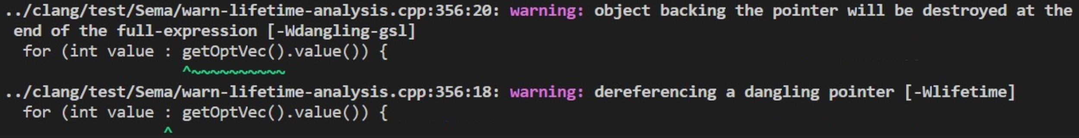
Nicer Diagnostics

Slide 44
Wait … can the analysis read my mind?
// Can p be null? void f(int* p);
void caller() {​
// I hope it can
f(nullptr);​
}
void f(int* p) {
// I hope it cannot
cout << *p;
}
Notes:
SWITCH TO MATTHIAS
Can it read my mind? With all that automatic inference, does it automatically understand what I mean? Even when just looking at a single function body at a time?
No, unfortunately will not read your mind any better than your colleagues can do.
Let's look at this example. Both we, as humans, as well as the analysis wonder whether the pointer p can be null on function entry.
It's important to decide whether the following line has a problem (and should cause a diagnostic) or not.
It's basically deciding whether there is an implicit contract on this function that guarantees that the parameter p is never null.
If that is the case, then we need to diagnose at call-sites that violate this implicit contract.

Slide 45
In summary
Statement-local analysis is done by Clang 10 by default
MSVC version coming
Try the –Wlifetime branch and give feedback
Contributors welcome!
Strive for consistent interfaces
Helps coworkers and static analysis
Notes:
First, We implemented statement-local analysis
Fast, no false-positives, enabled by default
Second, we talked

Slide 46




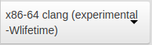
Resources
github.com/mgehre/llvm-project
godbolt.org
On the lifetime analyis:
CppCon 2018: Herb Sutter “Thoughts on a more powerful and simpler C++ (5 of N)” (from 19:00)
CppCon 2018: “Implementing the C++ Core Guidelines’ Lifetime Safety Profile in Clang”
EuroLLVM 2019: “Implementing the C++ Core Guidelines' Lifetime Safety Profile in Clang”
You might also like:
Killing Uninitialized Memory: Prot
4:45 today
C++ Sanitizers and Fuzzing for the Windows Platform Using New Compilers, Visual Studio, and Azure
in parallel, watch the recordings
The SLX FPGA poster

Slide 47
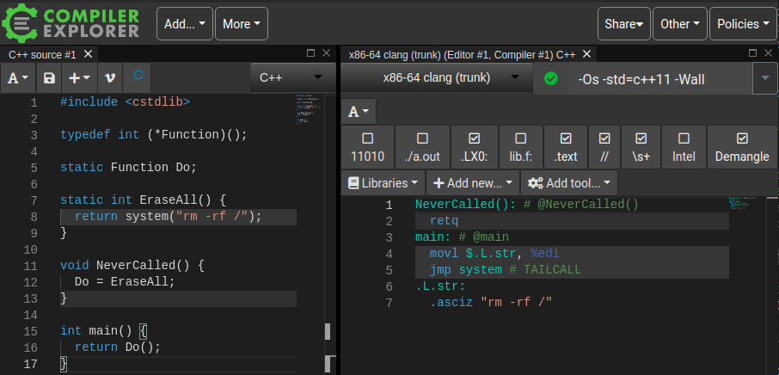
Undefined behavior is bad
Source: andreasdotorg @ twitter
Notes:
Talk about security: 70 percent •https://youtu.be/PjbGojjnBZQ

